Slide 1
Structured Systems Analysis and Design BCA-II Sem
By :- Dr. Pooja Nagpal Asst.Prof.(HIMT)Rohtak
Topic covered
System testing: Introduction, Objectives of testing, Test plan, testing techniques/Types of system tests, Quality assurance goals in system life cycle, System implementation, Process of implementation, System evaluation, System maintenance and its types, System documentation, Forms of documentation.

Slide 2
System testing: Introduction
Testing is the process of executing a program with the intention of finding errors
Testing is the process of establishing confidence that a program or system does what it is supposed to. by Hetzel 1973
Testing can show the presence of bugs but never their absence. by Dijkstra

Slide 3
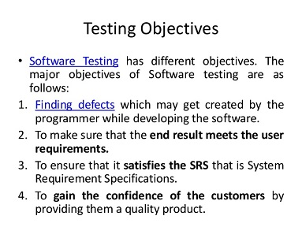

Slide 4
Test plan
What is a Test Plan?
Test planning, the most important activity to ensure that there is initially a list of tasks and milestones in a baseline plan to track the progress of the project. It also defines the size of the test effort.
It is the main document often called as master test plan or a project test plan and usually developed during the early phase of the project.

Slide 5
Test Planning Activities
To determine the scope and the risks that need to be tested and that are NOT to be tested.
Documenting Test Strategy.
Making sure that the testing activities have been included.
Deciding Entry and Exit criteria.
Evaluating the test estimate.
Planning when and how to test and deciding how the test results will be evaluated, and defining test exit criterion.
The Test artefacts delivered as part of test execution.
Defining the management information, including the metrics required and defect resolution and risk issues.
Ensuring that the test documentation generates repeatable test assets

Slide 6
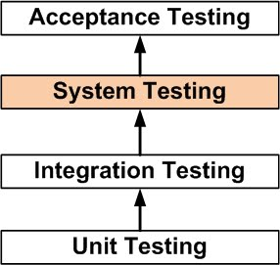
Testing techniques/Types of system Tests

Slide 7
Levels of testing
Unit testing
Unit testing is performed to test the individual units of the software
Detecting errors at unit level is simple, easy and take less time
Main points about Unit testing
Each unit is tested in isolation from other parts of a program
The developer them selves perform unit testing
Unit testing makes use of white box testing
Unit testing is used to verify the code produced during software coding and is responsible for assessing the correctness of a particular unit of source code

Slide 8
Integration Testing
After the completion of unit testing, integration testing begins
In integration testing, the units validated during the unit testing are combined to form a subsystem
The objective of integration testing is to take all the tested individual modules, integrate them, test them and develop the software, which is according to design specification

Slide 9
System testing
System testing means testing of entire software
Software is integrated with other elements such as hardware, people, and database to form a computer based system. This system is then checked for errors using system testing
System testing is defined as a testing conducted on a complete, integrated system to evaluate the system’s compliance (agreement) with its specified requirements’

Slide 10
Quality assurance goals in system life cycle
It is the review of system or software products and its documentation for assurance that system meets the requirements and specifications.
Purpose of QA is to provide confidence to the customers by constant delivery of product according to specification.
Software quality Assurance (SQA) is a techniques that includes procedures and tools applied by the software professionals to ensure that software meet the specified standard for its intended use and performance.
The main aim of SQA is to provide proper and accurate visibility of software project and its developed product to the administration.
It reviews and audits the software product and its activities throughout the life cycle of system development.
Objectives of Quality Assurance
The objectives of conducting quality assurance are as follows −
To monitor the software development process and the final software developed.
To ensure whether the software project is implementing the standards and procedures set by the management.
To notify groups and individuals about the SQA activities and results of these activities.
To ensure that the issues, which are not solved within the software are addressed by the upper management.
To identify deficiencies in the product, process, or the standards, and fix them.

Slide 11
Systems implementation
defining how the information system should be built (i.e., physical system design),
ensuring that the information system is operational and used,
ensuring that the information system meets quality standard (i.e., quality assurance).

Slide 12
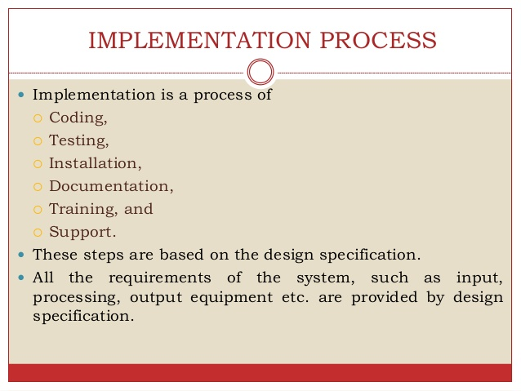

Slide 13
Software Evolution
The process of developing a software product using software engineering principles and methods is referred to as software evolution. This includes the initial development of software and its maintenance and updates, till desired software product is developed, which satisfies the expected requirements.
Evolution starts from the requirement gathering process. After which developers create a prototype of the intended software and show it to the users to get their feedback at the early stage of software product development. The users suggest changes, on which several consecutive updates and maintenance keep on changing too. This process changes to the original software, till the desired software is accomplished.
Even after the user has desired software in hand, the advancing technology and the changing requirements force the software product to change accordingly. Re-creating software from scratch and to go one-on-one with requirement is not feasible. The only feasible and economical solution is to update the existing software so that it matches the latest requirements.

Slide 14
System maintenance and its types
Maintenance means restoring something to its original conditions. Enhancement means adding, modifying the code to support the changes in the user specification. System maintenance conforms the system to its original requirements and enhancement adds to system capability by incorporating new requirements.
Thus, maintenance changes the existing system, enhancement adds features to the existing system, and development replaces the existing system. It is an important part of system development that includes the activities which corrects errors in system design and implementation, updates the documents, and tests the data.
Maintenance Types
System maintenance can be classified into three types −
Corrective Maintenance − Enables user to carry out the repairing and correcting leftover problems.
Adaptive Maintenance − Enables user to replace the functions of the programs.
Perfective Maintenance − Enables user to modify or enhance the programs according to the users’ requirements and changing needs.

Slide 15
System documentation
System documentation is a vital and important part of successful software development and software engineering. Generally speaking, it is comprised of detailed language, illustrations and photos that help different people understand the software, and it is essential reference material. Many developers face challenges in creating software documentation that is both comprehensively helpful and easy to read.
Different Types of Documentation
Computer software documentation is broadly defined. It can be a user manual that consumers read to understand the requirements and operations of a software system so they can then download it, install it and use it. It can also be more technical, describing the capabilities and characteristics of the system for a technical user, such as someone in IT or a systems administrator. Technical documentation can include coding for the software and a record of how it was designed, such as the architecture of the creation and the goals of designing the software and each of its aspects.
Documentation is designed to inform the reader about the software and describe how it was created, what it is intended to do and how it works. It should also be easy to find or access, and it should have the ability to be updated as changes are made to the software over the course of time. While details have to be included for documentation to be properly comprehensive and effective, the goal is for all computer software documentation to be written in language that’s fairly easily understood. This can be a challenge when using technical language.

Slide 16
Categories of Documentation
Overall, documentation can be divided into a couple of different categories: process documentation and product documentation. Process documentation is designed for those working in the internet technology field, and it uses industry-specific jargon about the process of engineering and developing the software. Product documentation describes the product and how it is to be used.
However, these categories are further divided. Product documentation includes both system documentation, which is technical, and user documentation, which should not be too technical. This is because it’s designed for the everyday average computer user, not someone in the software engineering or IT field.

